Slide 1
MATLAB Programming Midterm One – Part Two
Instructor: 黃世強 (Sai-Keung Wong)
TAs: 黃建洲, 蔡承恩, 林柏全

Slide 2
Midterm instruction
There are two sections. You must finish all of them.
1) Programming section (total 45pt)
You must implement a program to solve each problem
2) Report section (total 5pt = (3+2))
You must write a report to describe how you solve each problem
The approach for solving each problem must be clear and readable.
It contains a structure plan and shows clearly why such approach is adopted.
Each report must contain the number of words between 80 and 120 words in English. The marking scheme of the report is based on the correctness and clarity of the description of the approach. If you use fewer words to describe the approach, your score may be deducted.

Slide 3
Content
There are 2 questions. You must answer all of them.
Each program must be interactive. Deduct 5pt if the program is too slow to run.

Slide 4
About demo video/figure
A demo video/figure may have bugs. The demo video/figure shows roughly the results. These results may not be exactly the same as the requirements. They are for your own reference. You must follow the instruction to finish your programs.

Slide 5
Program file name format
Write all your programs in a folder. The folder name is mat_MT01_P2_ID. For example, if your student ID is 12345678, the folder name is
mat_MT01_P2_12345678 // folder name
Zip the folder and upload it.
Write a program for each problem in one file.
The file name is m01_X_yourStudentID.m, where X is the problem number.
For example, if your student ID is 12345678 and the problem number is 4, then the file name must be m01_4_12345678.m.
You must not output all the intermediate results.
Output the results that are required only.

Slide 6
File content header
At the top of the file, write down your name, ID, email address, department, and date.
%%%%%%%%%%%%%%%%%%%%%%%%%%%
% Midterm Number: …
% Problem number: …
% Student Name: …
% Student ID: …
% Email address: …
% Department:
% Date: ….
%%%%%%%%%%%%%%%%%%%%%%%%%%%%

Slide 7
File content
For each problem, display the problem number before showing the results.
close all; clear; clc; % close all windows
% clear variables, and clear screen
disp('Midterm Problem 1.1') % show Midterm Problem 1.1

Slide 8
(20 pts) Midterm Problem 1.4. Animation
Plot y(x) = [z1(x) sin(x) ] / z2(x)
z1(x) = (cos(s*x) + sin(s*x))*e^{-cos(x)}
z2(x) =(x+5)*(x-d)*(x-2*d)*e^{x*sin(s*x)}
The curve of y is divided into four segments due to three singular points.
0. Show your student name and ID. If you do not do so, your score is zero.
1. [2pt] Ask the user to input d in the interval [0,4]. This process is repeated until d is valid. If (d == 0), quit the program.
2. [13pt] Let s = [0.1:0.05:3]. For each value of s, draw the four segments. After a pause for 0.2 second, draw the segments for another s value. Repeat the process. Show the figure on top.
3. [3pt] Display each segment in different color. The line width of a curve is 3.
4. [2pt] The interval of x is [-10, 10]. Make sure that the segments are smooth. Set the limits of the y axis to -10 and 10.

Slide 9
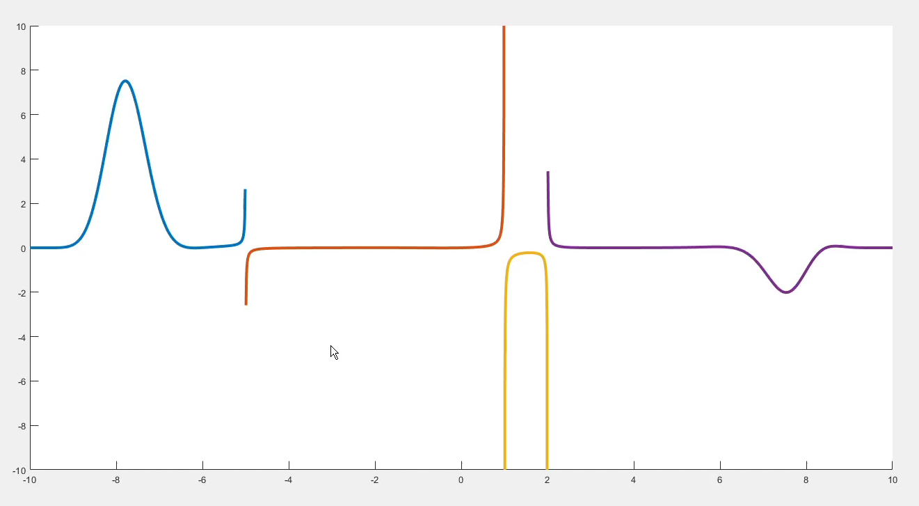
Midterm Problem 1.4. Animation
Play this video to see an animation
d=1

Slide 10
(25 pts) Midterm Problem 1.5
This program manipulates the image, tmp.png. Resize the image to [320 320]. The sweeping line moves 10 units a time. The program should be implemented using a loop-structure. Don’t quit the program until option 0 is selected.
The sweeping line with is 3.
The figure window must be set to the top of all the other windows. Deduct 5pt if not.
Reset the image: use the original image with dimension [320 320].
Ask to input an option. Hint: use input.
Options
disp('0) Show name and ID. Then Quit the program');
disp('1) Sweeping a line from left to right');
disp('2) Sweeping a line from right to left');
disp('3) Clear the red intensity of the image from left to right');
disp('4) Clear the red intensity of the image from right to left');
disp(‘5) Turn on or off a spot light at the top middle. Move it from top to bottom');

Slide 11
(25 pts) Midterm Problem 1.5
Don’t quit the program until option 0 is entered. Deduct 5pt if not.
The figure window must be set to the top of all the other windows. Deduct 5pt if not.
[1pt] Show the options.
0) Show your student name and ID. Then quit the program. If you do not do this, your score is zero.
1) [2pt] Reset the image. Sweeping a line from left to right. The animation must be smooth.
2) [2pt] Reset the image. Sweeping a line from right to left. The animation must be smooth.
3) [5pt] Reset the image. Clear the red intensity of the image from left to right, i.e., set red intensity of pixels to 0. Use a 320x10 rectangle at a time to clear the image. The animation must be smooth.
4) [5pt] Reset the image. Clear the red intensity of the image from right to left, i.e., set red intensity of pixels to 0. Use a 320x10 rectangle at a time to clear the image. The animation must be smooth.
5) [10pt] Reset the image. Turn on or off a spot light at the top middle of the image and then move it to the bottom. In other words, raise or reduce the intensities of pixels in a circular disk (i.e., filled circle) at the spot light. The radius of the disk is w/2, where w is the width of the image. If the spot light is on, it is off next time.

Slide 12
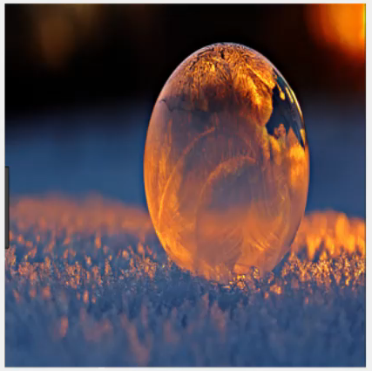
Midterm Problem 1.5
Play this video to see an animation

Slide 13
End
Enjoy MATLAB Programming.

